Slide 1
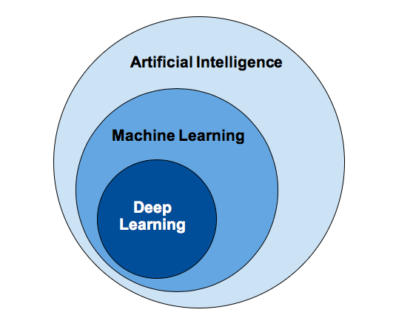
Deep Learning Intuitively
Day of Learning 17th Apr 2020

Slide 2

a learner’s perspective

Slide 3

You could expect
Recap (ML Session)
Groundwork
Perceptron
MLP
TensorFlow Basics
Basic use of math
CNN & RNN Basics ?

Slide 4

You shouldn’t expect
Tooling Details (Keras, PyTorch..)
Azure Offering
Visualization techniques
Algorithms List

Slide 5
Deep Learning
Deep learning (also known as deep structured learning or differential programming) is part of a broader family of machine learning methods based on artificial neural networks. Learning can be supervised, semi-supervised or unsupervised.
Deep learning architectures such as deep neural networks, recurrent neural networks and convolutional neural networks have been applied to fields including computer vision, speech recognition, natural language processing, audio recognition, social network filtering, machine translation…

Slide 6

Recap

Slide 7

Machine Learning Cliché
Data
Outcome
Traditional
Rules
Data
Rules
ML
Outcome

Slide 8

Terminology
Mean
Mode
Variance
Data
Parameter
Distribution
Dimension
Latent Variable
Covariance
Model
Hyper Parameter
Correlation
Objective Function
Similarity
Distance

Slide 9

Core Tenets
All machine learning problems are Optimization problems
Objective Function
Similarity & Distance

Slide 10

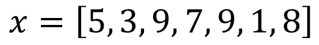
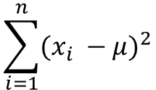
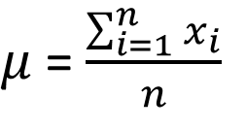
Mean, so mean?
Find a point that is a representation of all points
$$x=\left[5, 3, 9, 7, 9, 1, 8\right]$$
More technically find a point that is closest to all other points
$μ$= $\frac{\sum_{i=1}^{n}{x_{i}}}{n}$
= 6
Could it be?
3
9
5
1
$$\sum_{i=1}^{n}{{(x_{i} −μ)}^{2}}$$
Derivation?
8
7
9
What is data?
What is parameter?
Is there a hyper-parameter?

Slide 11

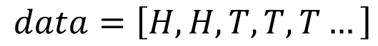
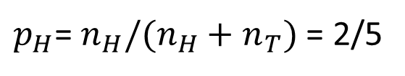
Likelihood
What is the likelihood of seeing a head in the next coin toss?
More technically, given the data, what is the maximum likelihood of seeing a head?
$$data=\left[H, H, T, T, T…\right]$$
$p_{H}$= $n_{H}/(n_{H}+n_{T})$ = 2/5
What is the objective function?

Slide 12



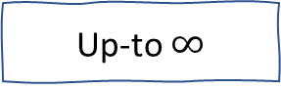
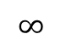
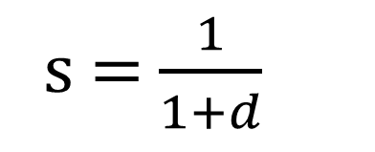
Similarity & Distance
Similarity
Distance
Similarity
Distance
=
0
!=
Up-to $∞$
$$∞$$
s = $\frac{1}{1+d}$
distance
1
similarity

Slide 13
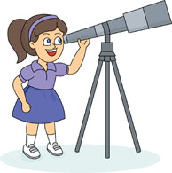
Distance & Similarity with Text
1
2
3
Hello World
Hello World
Hello John
Hello World
Hello World
Hello World
Hello
2
3
1
[Hello:1, World:1]
[Hello:4, World:4]
[Hello:1, John:1]
John
World
[Hello:1, World:1, John:0]
[Hello:4, World:4, John:0]
[Hello:1, World:0, John:1]
1
2
4
3
2
Hello
Remember Tfidf?
1
1
Remember BoW?
1
World
4

Slide 14

Groundwork

Slide 15
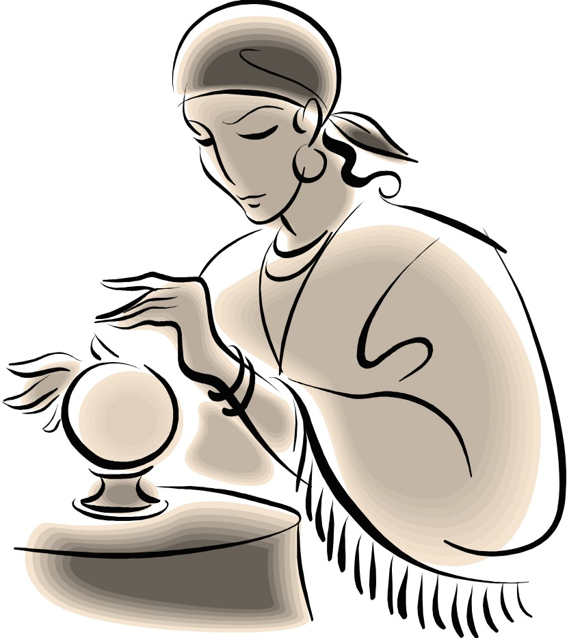

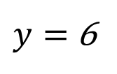
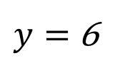
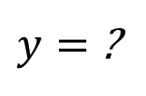
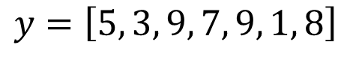
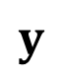
Predict the best y?
$$y$$
$y=$ 6
$$y=\left[5, 3, 9, 7, 9, 1, 8\right]$$
$y=$ ?
$$x$$
$y=$ 6

Slide 16
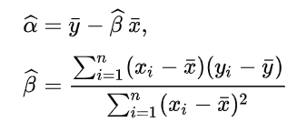
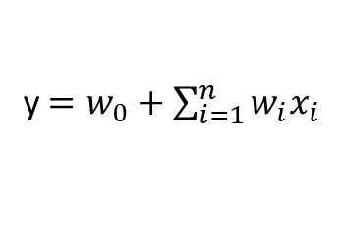
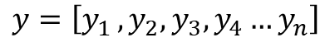
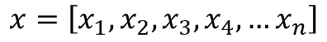
Linear Regression
y
y
y
x
x
x
$$x=\left[x_{1},x_{2},x_{3},x_{4}, …x_{n}\right]$$
Objective Function ?
Simple Linear Regression
$$y=\left[y_{1 },y_{2},y_{3},y_{4}…y_{n}\right]$$
Predict the best y?
y$=w_{0}+\sum_{i=1}^{n}{w_{i}x_{i}}$
OLS (Ordinary Least Square) [Loss, Cost]
Possibly? (SVM, LDA)

Slide 17
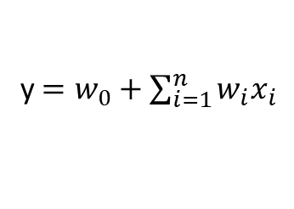
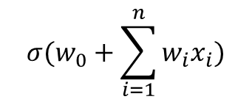
Logistic Regression
y
y
1
0
x
x
Which class the next data belongs to?
Does it still hold?
Sigmoid?
$${σ(w}_{0}+\sum_{i=1}^{n}{w_{i}x_{i})}$$
y$=w_{0}+\sum_{i=1}^{n}{w_{i}x_{i}}$
Regression => Classification

Slide 18


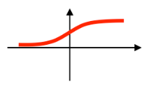
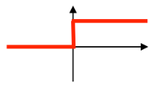
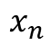
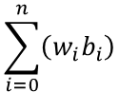
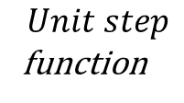
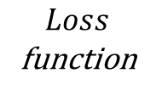
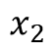
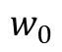
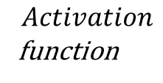
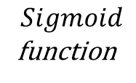
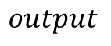
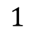
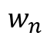
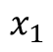
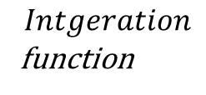
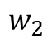
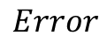
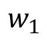
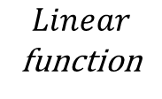
Conceptually
$$Loss$$
function
$$1$$
$$w_{0}$$
$$Error$$
$$x_{1}$$
$$w_{1}$$
$$\sum_{i=0}^{n}{\left(w_{i}b_{i}\right)}$$
$$output$$
$$x_{2}$$
$$w_{2}$$
$$Linear$$
function
$$Sigmoid$$
function
$$Unit step$$
function
$$x_{n}$$
$$w_{n}$$
$$Intgeration$$
function
$$Activation$$
function

Slide 19









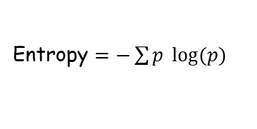
Entropy
average level of "information", "surprise", or "uncertainty" inherent in the variable's possible outcomes
X = The sun will rise from the east tomorrow
Y = The lockdown will continue tomorrow as well
50%
50%
75%
25%
If weather news update tells you, it will rain
If weather news update tells you, it will rain
Reduced uncertainty by 50% or 1/2
Reduced uncertainty by 3/4 and 1/4
Information provided is 1 bit (1 – rain, 0 – sun)
Information provided 0.41 and 2 bits
Can be expressed as $\log_{2}{2 }$or $\log_{2}{(\frac{1}{p}) }\text{or}$ ${− log}_{2}{(p) }$
Entropy $=−\sum{p \log{(p)}}$
12.5%
12.5%
12.5%
12.5%
12.5%
12.5%
12.5%
12.5%
If there are 8 possible states
Distribution ?
Reduced uncertainty by 1/8
Information provided is 3 bit (000 – rain, 001 – sun…)
Can be expressed as $\log_{2}{8 }$or $\log_{2}{(\frac{1}{p}) }\text{or}$ ${− log}_{2}{(p) }$

Slide 20
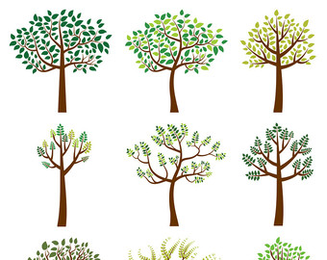





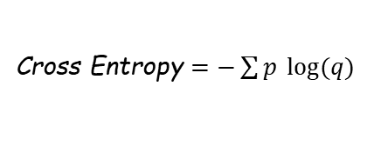
Cross Entropy
True distribution (p)
35%
35%
10%
10%
4%
4%
1%
1%
0%
0%
100%
0%
00
01
100
101
1100
1101
11100
11101
Entropy = (0.35*2 + 0.35*2 + 0.1*0.3…) = 2.42 bits
10%
25%
40%
25%
Predicted distribution (q)
1%
1%
4%
4%
10%
10%
35%
35%
Classifier
00
01
100
101
1100
1101
11100
11101
Cross Entropy = (0.01*2 + 0.01*2 + 0.04*0.3…) = 4.58 bits
Cross Entropy $=−\sum{p \log{(q)}}$
H(P, Q) = H(P) + KL(P || Q)

Slide 21

Deep Dive?

Slide 22

Inspiration

Slide 23
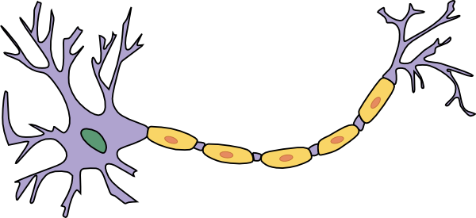

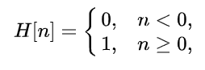
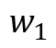
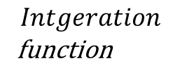
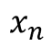
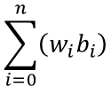









Perceptron (SLP)
perceptron algorithm was invented in 1958 at the Cornell Aeronautical Laboratory by Frank Rosenblatt
$$1$$
$$w_{0}$$
Looks familiar?
$$Error$$
$$x_{1}$$
$$w_{1}$$
$$\sum_{i=0}^{n}{\left(w_{i}b_{i}\right)}$$
$$output$$
$$x_{2}$$
$$w_{2}$$
$$Intgeration$$
function
$$Activation$$
function
$$x_{n}$$
$$w_{n}$$

Slide 24





Integration
$$x=\left[x_{1},x_{2},x_{3},x_{4}, …x_{n}\right]$$
May be 2 lines?
Can we change the integration function?
$$y=\left[y_{1 },y_{2},y_{3},y_{4}…y_{n}\right]$$
How will a perceptron learn 2 lines?
y$=w_{0}+\sum_{i=1}^{n}{w_{i}x_{i}}$
y$=w_{0}+\sum_{i=1}^{n}{w_{i}x_{i}^{2}}$

Slide 25



Activation

Slide 26

















Error
How does a perceptron learn?
$w_{j+1}=w_{j}+ η \left(y_{i}^{true} − y_{i}^{pred}\right)$ $x_{i}$
$$Line equation$$
$$w_{1}x_{1}+w_{2}x_{2}=0$$
$$Initial weights$$
$w=\left[\begin{aligned}0 \\ 1\end{aligned}\right]$
x2
$$[1]$$
$$learning rate$$
$η=1/3$
$$(1/2, 1)$$
$$[0]$$
$$[1]$$
$$First epoch?$$
$$(−1, 1/2)$$
$$(1, 1/2)$$
x1
$$[0]$$
$$(−1, −1)$$

Slide 27


Gradient Descent (SGD, BGD, MBGD)
optimization algorithm used to minimize some function by iteratively moving in the direction of steepest descent as defined by the negative of the gradient

Slide 28









Question
Can a perceptron learn an XOR?
x2
$$[0]$$
$$[1]$$
$$(−1, 1)$$
$$(1, 1)$$
x1
$$[1]$$
$$[0]$$
$$(1, 1)$$
$$(1, −1)$$

Slide 29

Multi Layer Perceptron (MLP)
ANN
Architecture
Deep (Many Layers)
Back Propagation
Number of Weights
ReLU & Softmax
Parameter & Hyper parameter
Playground

Slide 30

Examples

Slide 31

CNN & RNN
Next Session

Slide 32


Good Read

Slide 33

Q & A

